Slide 1
Netflix Movies & TV Shows:
Data Analysis
Exploring trends in genre popularity, viewer engagement, and language diversity across the Netflix catalog.

Slide 2
Outline
Executive Summary
Introduction
Methodology
Results
Visualization – Charts
Dashboard
Discussion
Findings & Implications
Conclusion
Appendix

Slide 3
Executive Summary
Netflix Movies & TV Shows Dataset: Key Findings
Drama dominates the catalog with ~3,700 titles, far exceeding all other genres
Adventure leads in both average popularity (~54) and average vote count (~2,300)
English-language content accounts for over 7,500 titles
Malayalam (ML) content achieves the highest average popularity (~150)
English-language titles lead in average vote count (~1,670)
Dataset: ~9,000+ Netflix titles across multiple languages and genres with popularity and vote metrics

Slide 4
Introduction
Netflix Movies & TV Shows Dataset – Context & Purpose
Dataset: Movie and TV show metadata scraped from Netflix/TMDB (Kaggle – Nalisha, 2022)
Target: Popularity, vote count, and vote average across genres and languages
Purpose: Identify content patterns to support catalog strategy and recommendation insights
Audience: Data analysts, content strategists, streaming platform researchers
Variables include title, genre, original language, popularity score, vote count, vote average, and release date
Analysis focuses on 6 key visualizations: popularity by genre, movie count by genre, vote count by genre, popularity by language, movie count by language, and vote count by language

Slide 5
Methodology
Data Source & Analytical Approach
Source: Netflix Movies and TV Shows dataset (Kaggle – Nalisha)
~9,000+ observations with columns: Title, Genre, Original_Language, Popularity, Vote_Count, Vote_Average
Tools: Python (pandas, numpy, seaborn, matplotlib)
Steps: Load → drop missing values → convert data types → normalize → create categorical bins → build pivot tables → visualize
Popularity_Category (Low/Moderate/High/Trending)
Vote_Count_Category (Niche/Limited/Popular/Mainstream)
Vote_Average_Category (Poor/Average/Good/Excellent)
Dummy variables created for Original_Language and Genre to enable binary aggregation

Slide 6

Results
Six exploratory visualizations reveal patterns in content popularity, volume distribution, and audience engagement across Netflix genres and languages.

Slide 7
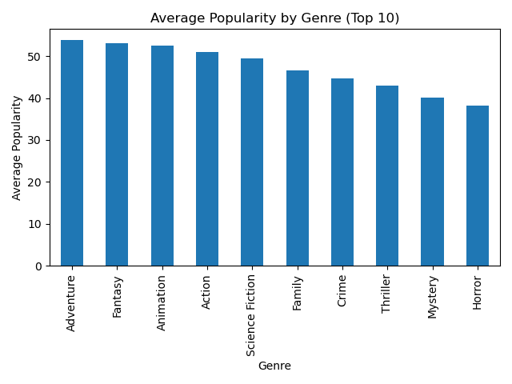
Average Popularity
by Genre
Key Insight
Adventure leads all genres in average popularity (~54), followed closely by Fantasy (~53) and Animation (~52). Action and Science Fiction round out the top five. Horror ranks lowest among the top 10 at ~38, suggesting it attracts a more niche but consistent audience.

Slide 8
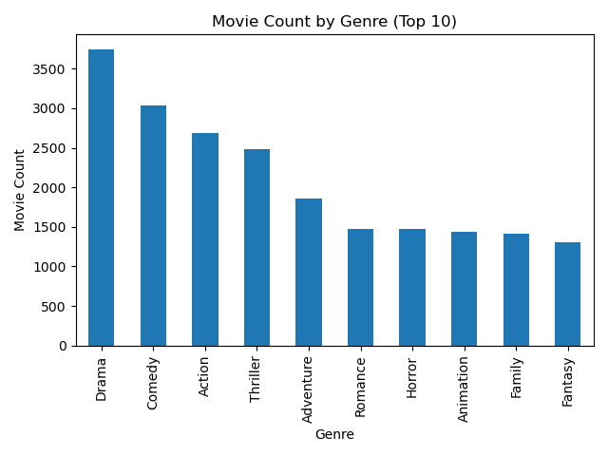
Movie Count by Genre
Key Insight
Drama is by far the most represented genre with ~3,700 titles, nearly 700 more than Comedy in second place (~3,030). Action and Thriller follow with ~2,700 and ~2,500 titles respectively. The top four genres make up a disproportionate share of the catalog, while Fantasy at ~1,300 titles sits at the edge of the top 10.

Slide 9
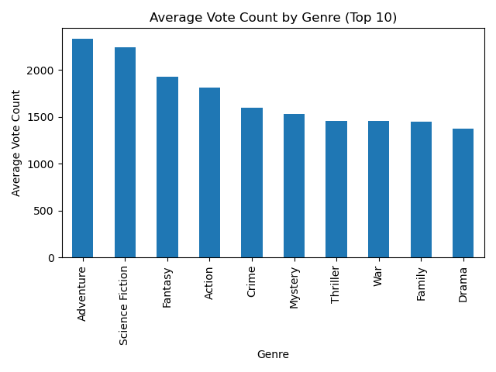
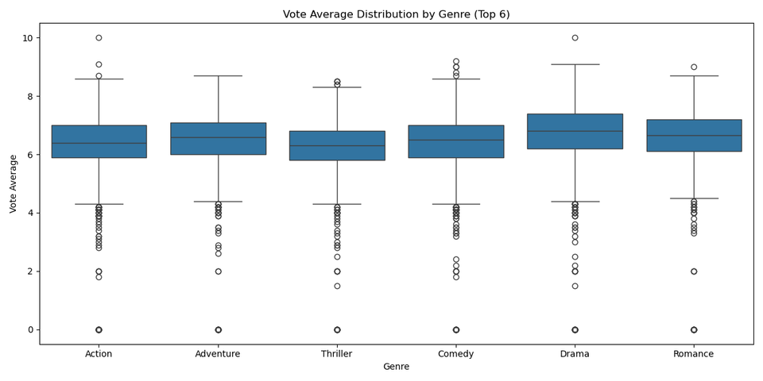
Average
Vote Count
by Genre
Key Insight
Adventure and Science Fiction dominate audience engagement with average vote counts of ~2,300 and ~2,200 respectively, significantly higher than Fantasy (~1,950) and Action (~1,800). Drama, despite having the most titles, ranks lowest among the top 10 in vote count (~1,370), indicating it draws volume but lower per-title engagement.

Slide 10
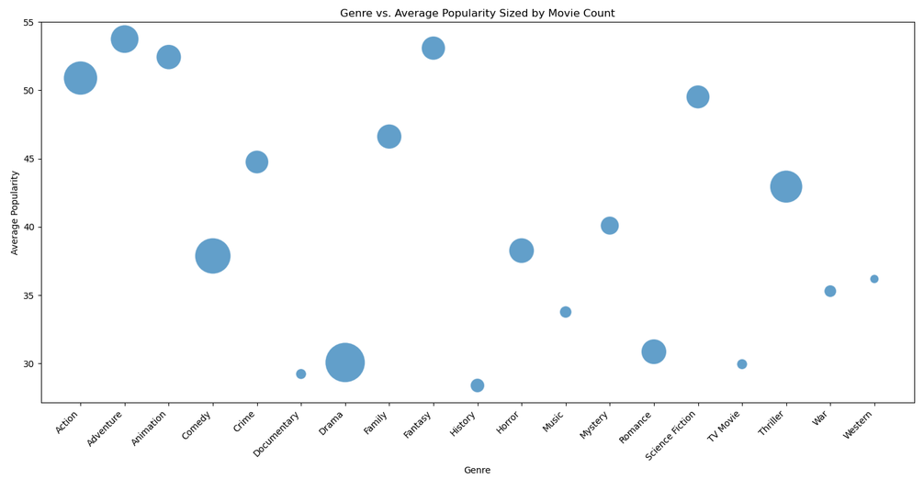
Genre vs.
Popularity Bubble
Key Insight
Adventure, Animation, and Fantasy achieve the highest average popularity despite moderate catalog sizes, shown by their large bubbles at the top of the chart. Drama, the largest genre by volume, clusters near the bottom in popularity (~30), reinforcing that catalog size does not drive per-title audience interest.

Slide 11
Findings & Implications
Findings
Drama is the highest-volume genre but ranks last in average vote count among top genres
Adventure excels in both popularity and vote count, making it the most engaging genre overall
Science Fiction achieves top-tier engagement despite moderate catalog size
Genre and popularity are not strongly correlated: high genre volume does not guarantee high average popularity scores
Implications
High-volume genres like Drama may suffer from content dilution; quality filtering could improve engagement
Adventure and Sci-Fi titles are strong candidates for featured promotion and algorithmic boosting
Low-popularity genres like Horror serve loyal niche audiences and may benefit from targeted recommendation
Tracking popularity trends by genre over time can help identify emerging genres before they peak, supporting proactive catalog investment

Slide 12
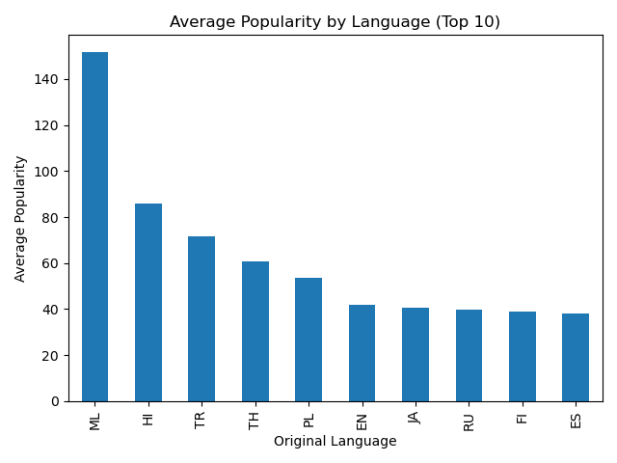
Average Popularity
by Language
Key Insight
Malayalam (ML) content achieves dramatically higher average popularity (~150) than all other languages, which nearly doubles that of Hindi (HI) at ~86, and more than double Turkish (TR) at ~71. English (EN) ranks only sixth (~42), suggesting non-English content punches well above its catalog weight in audience interest.

Slide 13
Findings & Implications
Findings
Malayalam (ML) content achieves the highest average popularity by a wide margin (~150 vs ~86 for Hindi)
English dominates in total title volume (~7,500), but ranks only 6th in average popularity
Japanese content is the second most represented language (~600 titles) after English
Implications
Non-English content, especially South Asian and Southeast Asian, generates outsized popularity relative to catalog size
Investing in Malayalam, Hindi, and Turkish originals could yield high popularity returns at lower production scale
English-language dominance in volume may suppress its own average popularity metric

Slide 14

Additional Analysis
Extended findings on audience vote patterns, language-level engagement, and cross-variable relationships.

Slide 15
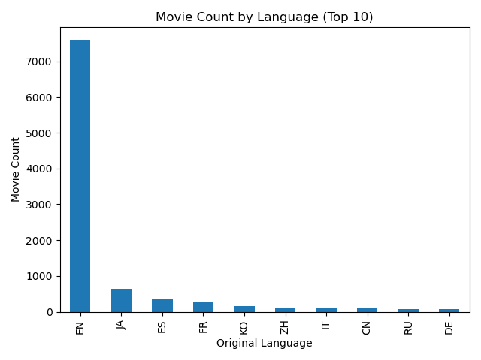
Movie Count by Language
Key Insight
English (EN) content accounts for ~7,500 titles, which is more than 12 times the next largest language, Japanese (JA) at ~600. Spanish (ES) and French (FR) follow at ~350 and ~280. The remaining languages each account for under 200 titles, highlighting the heavily English-centric nature of the Netflix catalog.

Slide 16
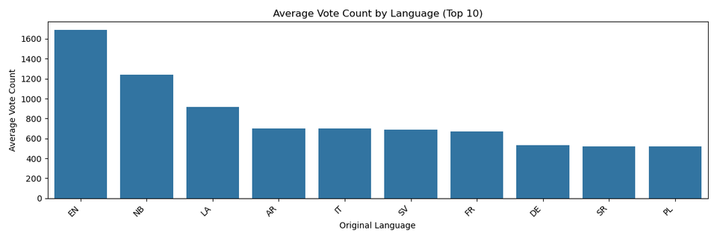
Average
Vote Count
by Language
Key Insight
English (EN) leads in average vote count (~1,670), followed by Norwegian (NB) at ~1,240 and Latin (LA) at ~920. Arabic (AR), Italian (IT), Swedish (SV), and French (FR) cluster closely between ~680–700. The pattern suggests that English-language titles benefit from a much larger global voter base, inflating their average engagement metrics.

Slide 17

Cross-Variable Relationships
Correlation Summary – Variable Interactions
High-volume genres (Drama, Comedy) do not correlate with high popularity or vote counts
Adventure and Sci-Fi show the strongest pairing of popularity AND vote engagement
Non-English languages with small catalogs (ML, HI) outperform English in average popularity
English-language content's large volume inflates total vote counts but dilutes average popularity
These patterns suggest a combined model using Genre, Language, and Vote Count would be predictive of Popularity

Slide 18
This analysis reveals that Netflix content performance is shaped by a complex interplay of genre identity, language origin, and audience reach. High-volume genres like Drama dominate the catalog but exhibit lower per-title engagement, while niche high-energy genres like Adventure and Science Fiction generate stronger audience interest. Non-English content, particularly from South and Southeast Asia, consistently outperforms in popularity metrics despite representing a small fraction of total titles. These patterns suggest that catalog diversification, targeted promotion of high-engagement genres, and strategic investment in underrepresented language markets could significantly improve platform-wide audience satisfaction and engagement.
Discussion

Slide 19
Overall Findings & Implications
IMPLICATIONS
FINDINGS
Content strategy should balance volume with engagement quality, which is more titles do not guarantee more popularity
Investment in Adventure, Sci-Fi, and international originals offers the highest expected engagement return
Language diversity in the catalog is an underexploited lever for growing global audience popularity
Drama leads in volume but trails in per-title popularity and vote engagement
Adventure is the top-performing genre across both popularity and vote count metrics
Non-English content (ML, HI, TR) achieves disproportionately high popularity scores relative to catalog size

Slide 20
Conclusion
Netflix content popularity is driven more by genre energy and cultural relevance than by catalog volume
Non-English languages, especially Malayalam, Hindi, and Turkish, generate outsized popularity despite limited representation
Adventure and Science Fiction are the strongest genre investments for maximizing audience engagement
EDA confirms that genre, language, and vote count are actionable predictors for content recommendation and acquisition strategy

Slide 21
Dataset: Nalisha (2022). Netflix Movies and TV Shows Data Analysis. Kaggle. https://www.kaggle.com/datasets/nalisha/netflix-movies-and-tv-shows-data-analysis
Variables: Title, Genre, Original_Language, Popularity, Vote_Count, Vote_Average, Release_Date
Tools: Python 3.x — pandas, numpy, seaborn, matplotlib | Encoding: latin-1
Preprocessing: dropna (rows & cols), type casting, categorical binning, dummy encoding, pivot table aggregation
Appendix

